Slide 1






React.js Fundamentals
Course Overview,
Trainers, Evaluation
React.js
Development
SoftUni Team
Technical Trainers
Software University
http://softuni.bg

Slide 2



Table of Contents
Course Objectives
Course Program
Trainers Team
Course Schedule
Exams and Evaluation
Learning Resources

Slide 3
Have a Question?
sli.do #js-web

Slide 4

Express.js Fundamentals
Course Objectives & Program

Slide 5



Course Objectives
The React.js Fundamentals course provides
Fundamental understanding of JSX and React
Covers component-based architecture
Establishes Immutable UI concepts with Redux
What is NOT covered?
JavaScript basics and REST communication
Optimization and Web Components

Slide 6
Warning: Not for Absolute Beginners
The "React.js" course is NOT for absolute beginners
Take the HTML & JavaScript courses at SoftUni first: https://softuni.bg/trainings/1271/web-fundamentals-html-css-november-2015 https://softuni.bg/trainings/1295/javascript-basics-january-2016
This course is OK for beginners, but requires previous coding skills
Requirements
HTML & JS (ES 2016) coding skills – intermediate level
Computer English – entry level

Slide 7

Course Topics
React.js overview, JSX syntax
Components, state, lifecycle
Events, forms, composition
Routing, higher order components
State management with Redux
Asynchronous data with Redux

Slide 8

The Trainers Team

Slide 9

Trainers Team
Ivaylo Kenov
Various job titles at the same time:
Mathematical competitions champion
Full Stack Technical Trainer
Senior Software Developer
Solutions Architect & Technical Lead
One-man army @ https://MyTestedASP.NET
{Insert Jot Title Here}
Contacts
https://github.com/ivaylokenov
https://facebook.com/ivaylo.kenov
https://linkedin.com/in/kenov

Slide 10
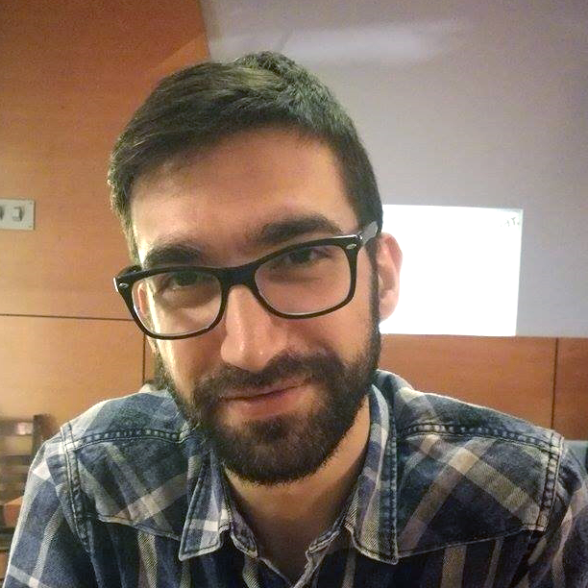
Trainers Team (2)
Viktor Kostadinov
Training Director @ Software University
Experienced Technical Trainer
Passionate about JavaScript
Programmed as a hobby since high school
Interests include astronomy and game development

Slide 11
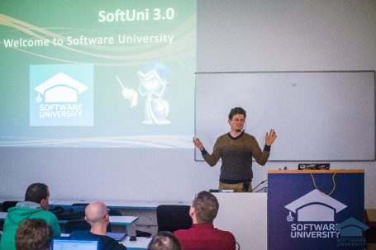


React.js Fundamentals
Course Details and Schedule

Slide 12

Training Duration
Lessons: ~30 hours (onsite + videos)
Practical exercises (in class): ~30 hours
Project Defense: 6 hours
Defense date: 15 July 2018

Slide 13

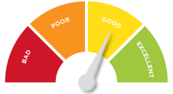
Scoring System for the Course
Project – 90%
Homework (exercises) – 10%
Bonuses: up to 10%
Presence in class: 5% (onsite students only)
Forum activities: 5%

Slide 14



Learn to Search Online
The course assignments require searching online
This is an important part of the learning process
Some exercises intentionally have no hints
Learn to find solutions!
Software development includes everyday searching and learning
No excuses, just learn to study!
Developers learn new technologies, tools, languages every day!

Slide 15

Homework Assignments
Doing your homework is very important!
Programming can only be learned through a lot of practice!
You should write code every day!
Each lesson is followed by many exercises
Try to solve them in class
The rest are your homework
Homework assignments are due 7 days after each lecture
Submission through the course page

Slide 16










Resources
What We Need Additionally?

Slide 17


Your RFID Chip
Students can either
Take RFID chip from SoftUni
Or use their own chip / card (125 KHz)
Register your chip number in your SoftUni profile: https://softuni.bg/users/profile/show
Check-in at the reception every time when you come in SoftUni
See your last visits in your profile: https://softuni.bg/users/profile/show

Slide 18



Course Web Site, Forum and FB Group
Official web site:
Official discussion forum:
Official Facebook group:
softuni.bg/courses/reactjs-fundamentals
softuni.bg/forum/categories/109/React-js
fb.com/groups/SoftUniJSWebMay2018

Slide 19

The Software Technologies Slides and Videos
All lecture slides, videos, homework assignments, projects and other resources are open content, available for free
Visit the course web site to access the course resources

Slide 20


Recommended Software
Node.js (Current Version)
Development Environment
Or an IDE of your choice
https://nodejs.org/en/download/
https://code.visualstudio.com/
https://jetbrains.com/webstorm/

Slide 21












Course Introduction
https://softuni.bg/courses/

Slide 22
License
This course (slides, examples, demos, videos, homework, etc.) is licensed under the "Creative Commons Attribution-NonCommercial-ShareAlike 4.0 International" license

Slide 23





Trainings @ Software University (SoftUni)
Software University – High-Quality Education, Profession and Job for Software Developers
softuni.bg
Software University Foundation
http://softuni.foundation/
Software University @ Facebook
facebook.com/SoftwareUniversity
Software University Forums
forum.softuni.bg

